Slide 1
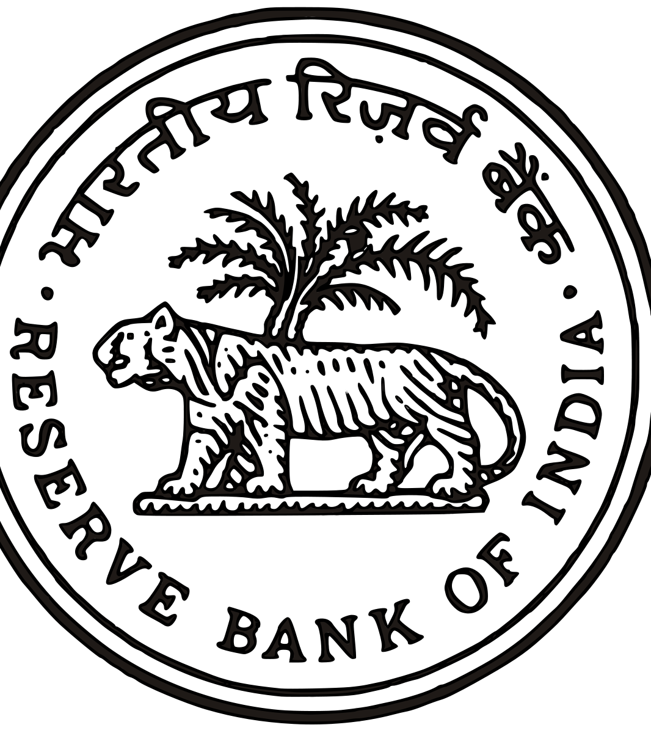
IMPACT OF MONETARY POLICY ON ENGINEERING INDUSTRY
Rinkal singh

Slide 2
INTRODUCTION Monetary policy refers to the use of instruments under the control of the central bank to regulate the availability, cost and use of money and credit. Objectives • Maintaining price stability • Ensuring adequate flow of credit to the productive Sectors of the economy • Rapid economic growth • Balance of payment equilibrium • Full employment • Equal income distribution INTRODUCTION Monetary policy refers to the use of instruments under the control of the central bank to regulate the availability, cost and use of money and credit. Objectives • Maintaining price stability • Ensuring adequate flow of credit to the productive Sectors of the economy • Rapid economic growth • Balance of payment equilibrium • Full employment • Equal income distribution
INTRODUCTION Monetary policy refers to the use of instruments under the control of the central bank to regulate the availability, cost and use of money and credit.
Objectives • Maintaining price stability • Ensuring adequate flow of credit to the productive Sectors of the economy • Rapid economic growth • Balance of payment equilibrium • Full employment • Equal income distribution

Slide 3
Direct Instruments
The money supply in the economy is influenced by CRR.
It is the ratio of a bank’s time and demand liabilities to be kept in reserve with RBI.
It is the ratio of a bank’s time and demand liabilities to be kept in reserve with RBI
It is the ratio of a bank’s time and demand liabilities to be kept in reserve with RBI.
It is the ratio of a bank’s time and demand liabilities to be kept in reserve with RBI.
✓ The RBI is authorized to vary the CRR between 3% and 15%.
Statutory liquidity ratio (SLR):
Under SLR, banks have to invest a certain percentage of its time and demand liabilities in govt. approved securities.
The reduction in SLR enhances the liquidity of commercial banks. Indirect Instruments
Liquidity Adjustment Facility (LAF): – Consists of daily infusion or absorption of liquidity on a repurchase basis, through repo (liquidity injection) and reverse repo (liquidity absorption) auction operations, using government securities as collateral.
Repo Rate: – Repo rate is the rate at which the RBI lends shot-term money to the banks against securities. When the repo rate increases borrowing from RBI becomes more expensive.
Reverse Repo Rate: – The rate at which RBI borrows from commercial banks.

Slide 4
How does monetary policy affect
Expansionary Monetary policy
central bank buys securities through open market operations.
It lowers bank rate
It reduces cash reserve ratio
Interest ratio falls
Investment increases
Aggregate demand increases
Recession and Unemployment
Contractionary Monetary policy
Central Bank sells securities through open market operations
It raises Bank rate
It raises cash raise ratio and Statuatory liquidity ratio
It raises maximum margin against securities or holding of stocks and goods
Money supply decreases
Interest rate rises
Investment expenditures declines
Aggregate demand declines
Inflation rate falls

Slide 5
Year | interest | Net Sales | No. of companies
Latest | 118.35 | 2,508.92 | 20
2008 | 26.17 | 978.1 | 7
2009 | 36.24 | 953.39 | 6
2010 | 41.28 | 1,133.40 | 7
2011 | 53.13 | 1,572.14 | 9
2012 | 77.05 | 1,701.25 | 9
2013 | 96 | 2,108.87 | 11
2014 | 79.03 | 1,561.88 | 10
2015 | 124.12 | 2,505.82 | 11
2016 | 104.9 | 2,174.40 | 9
2017 | 68.11 | 824.52 | 4
SUMMARY OUTPUT
Regression Statistics
Multiple R | 0.90938
R Square | 0.826972
Adjusted R Square | 0.807747
Standard Error | 272.2635
Observations | 11
ANOVA
 | df | SS | MS | F | Significance F
Regression | 1 | 3188570 | 3188570 | 43.01472 | 0.000104
Residual | 9 | 667146.7 | 74127.41
Total | 10 | 3855717
 | Coefficients | Standard Error | t Stat | P-value | Lower 95% | Upper 95% | Lower 95.0% | Upper 95.0%
Intercept | 373.7387 | 209.5764 | 1.783305 | 0.10821 | -100.356 | 847.8336 | -100.356 | 847.8336
X Variable 1 | 16.87518 | 2.573001 | 6.558561 | 0.000104 | 11.05465 | 22.69572 | 11.05465 | 22.69572

